Slide 1
Inseason Canadian Origin Yukon Chinook Projection
Workflow instructions for running the model inseason
Aaron Lambert, UAF-CFOS

Slide 2
Import Data From ADF&G
Preprocess excel worksheet using Dataframe preprocess.R
Run the model using the InSeasonProjection function
Use the outPlots function to view projection
Select current year, the day of year with the latest PSS report

Slide 3
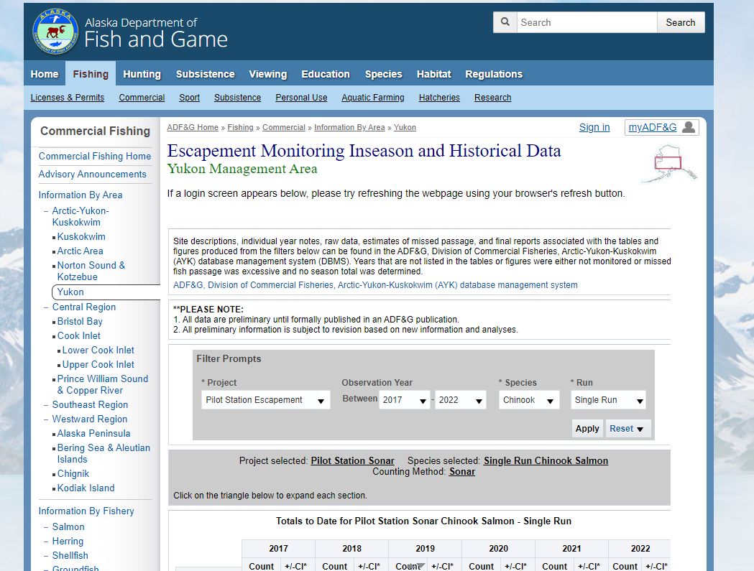
Step 1- Import data
Go to https://www.adfg.alaska.gov/index.cfm?adfg=commercialbyareayukon.salmon_escapement

Slide 4
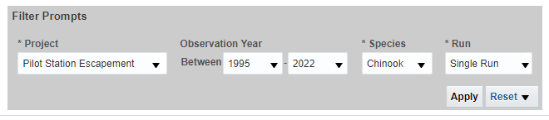
Step 1- Import data
Go to https://www.adfg.alaska.gov/index.cfm?adfg=commercialbyareayukon.salmon_escapement
Select years 1995 – current year in filter prompts window. Click apply

Slide 5
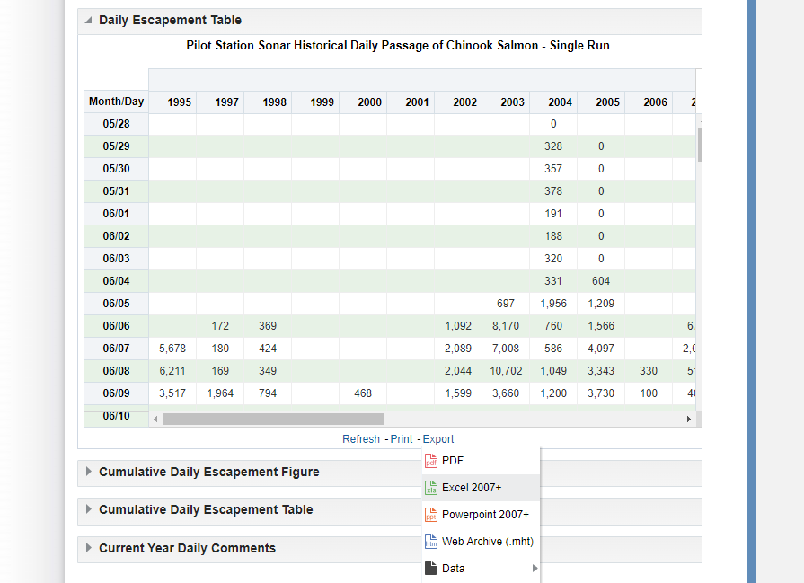
Step 1- Import data
Go to https://www.adfg.alaska.gov/index.cfm?adfg=commercialbyareayukon.salmon_escapement
Select years 1995 – current year in filter prompts window. Click apply.
Scroll down to Daily Escapement Table and export as Excel 2007+

Slide 6
Step 1- Import data
Go to https://www.adfg.alaska.gov/index.cfm?adfg=commercialbyareayukon.salmon_escapement
Select years 1995 – current year in filter prompts window. Click apply
Scroll down to Daily Escapement Table and export as Excel 2007+
Save in data folder within the Inseason Projection folder. This should be in the working directory for the r working script. If done correctly, dir.data will direct R to the proper data folder (see step 2).

Slide 7
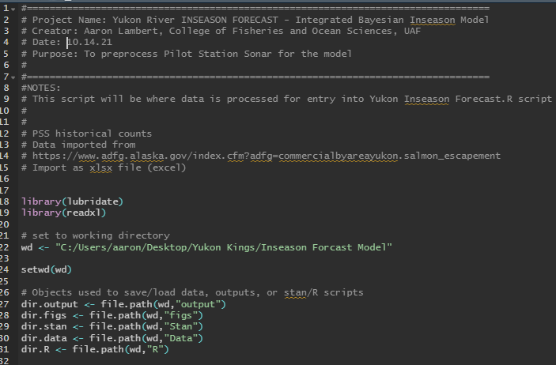
Step 2- Process PSS data in R
Open the “Dataframe preprocess.R” script and run the entire script. (Make sure the working directory is properly set)

Slide 8
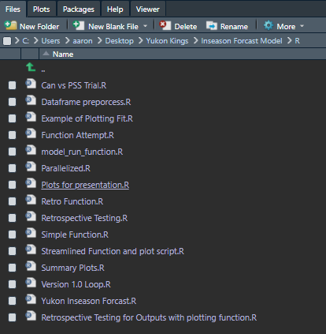
Step 3- Select options for model
Open the “Streamlined Function and Plot Script.R” script.

Slide 9
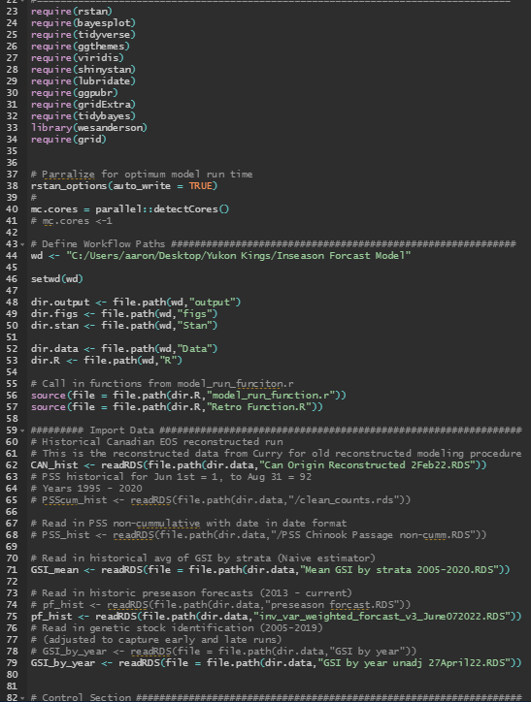
Step 3- Select options for model
Open the “Streamlined Function and Plot Script.R” script.
Run the code to the Control Section. *Note* Do not import PSS_hist, as this should already be in the environment from step 2.

Slide 10
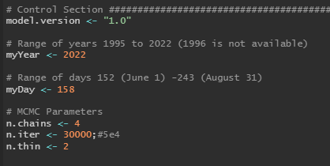
Step 3- Select options for model
Open the “Streamlined Function and Plot Script.R” script.
Run the code to the Control Section. *Note* Do not import PSS_hist, as this should already be in the environment from step 2.
Next, enter the model version, myYear (year of interest (typically the current year)), myDay (day of interest), and any specific MCMC parameters for the stan model (These can usually be left as is).

Slide 11
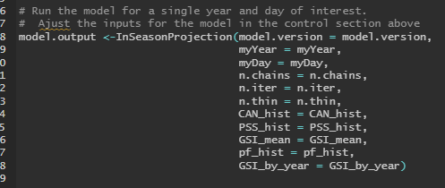
Step 3- Run the model
Run the model

Slide 12
Step 3- Run the model
Run the model
The results will be saved in an object called “model.ouput”, which is a list.

Slide 13
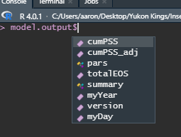
Step 3- Run the model
Run the model
The results will be saved in an object called “model.ouput”, which is a list.
The model.output list contains parameter estimates, the model version used, a model summary, and some other objects used for plotting.

Slide 14
Step 4- Generate Figures
Use the function outPlots with the argument “outputList” = model.output
*Note* GSI argument must be TRUE if using model versions that adjust by Canadian GSI proportions

Slide 15
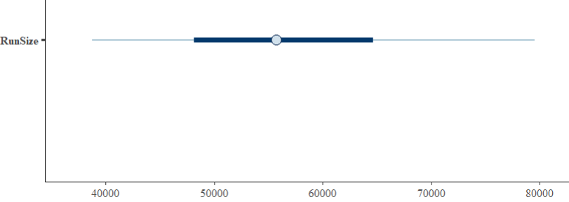
Step 4- Generate Figures
Use the function outPlots with the argument “outputList” = model.output *Note* GSI argument must be TRUE if using model versions that adjust by Canadian GSI proportions
Other plots can be created with the model.output list. For example, intervals can be generated by using the bayesplot package with the fit saved in model.output is the saveFit = TRUE argument is used when generating the model posterior draws.

